Slide 1
Demolition Before Construction (Rebooted – Chapter 18)
Last Week’s Presentation Combined Portions of Both Chapters

Slide 2
Who ARE These Guys?
Ashcraft, Morris – Professor of Theology, Midwestern Baptist Theological Seminary
Beasley-Murray, George R. – Principal of Spurgeon’s College, London; New Testament, The Southern Baptist Theological Seminary
Bowman, John Wick – Ph.D. The Southern Baptist Theological Seminary and post-graduate (Fulbright scholar) University of Zurich
Caird, G. G. – Principal of Mansfield College, Oxford University
Carroll, B. H. – Founder, Southwestern Baptist Theological Seminary
Charles, R. H. –Professor of Greek, Trinity College (Dublin, Ireland)
Hendriksen, William – New Testament Professor, Calvin Theological Seminary
Hough, Lynn Harold – former Dean of Drew Theological Seminary
Ladd, G. E. – New Testament Professor, Fuller Theological Seminary
Lindsey, Hal – Christian Zionist and Dispensational Author
Metzger, Bruce – Professor of New Testament and Greek, Princeton University
Morris, Leon – Principal of Ridley College, Melbourne
Palmer, Earl – Pastor Emeritus, University Presbyterian, Seattle
Reddish, Mitchell – Chairman of Religious Studies, Stetson University
Rist, Martin – New Testament Professor / Iliff School of Theology
Robertson, A. T. – Professor of New Testament, The Southern Baptist Theological Seminary
Summers, Ray – Professor of New Testament and Greek, Southwestern Baptist Theological Seminary and Baylor University
Swete, H. B. – Regius Professor of Divinity, Cambridge University
Talbot, Louis T. – President, Talbot Theological Seminary
Woodbridge, Charles J. – Presbyterian Missionary to French Cameroons

Slide 3
Revelation 17 (angel/guide) Revelation 18 (angel/herald)
“So recently has he come from the Presence that in passing he flings a broad belt of light across the dark earth.” (H. B. Swete)
“Three aspects of John’s description emphasize the power of this angel: he has ‘great authority’ (18:1), makes the earth ‘bright with his splendor’ (18:1), and ‘speaks with a mighty voice’ (18:2).” (Mitchell Reddish)
“After the unholy city Rome/Babylon (18:1-24) has been destroyed, its eschatological counterpart, the holy city New Jerusalem, appears as the new creation of God.” (Udo Schnelle)

Slide 4
Quotations and One-Time Appearances

Slide 5
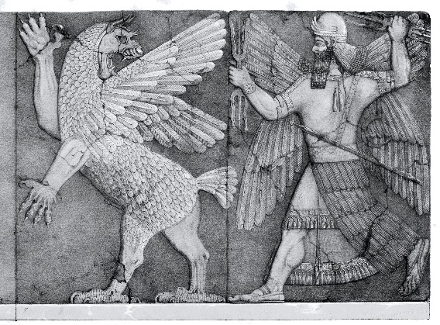
Then, Now, and When?
Old Testament Taunt Songs
Revelation 18
“And he answered, ‘Fallen, fallen is Babylon; and all the graven images of her gods are broken on the ground.’” (Isaiah 21:9 ASV)
“Babylon is taken, Bel is put to shame, Merodach is dismayed; her images are put to shame, her idols are dismayed.” (Jeremiah 51:2b ASV)
“…and desolation shall come upon thee suddenly…” (Isaiah 47:11b ASV) “But wild beasts of the desert shall lie there; and their houses shall be full of doleful creatures; and ostriches shall dwell there, and wild goats shall dance there (13:21 ASV)
“And he cried with a mighty voice, saying, ‘Fallen, fallen is Babylon the great, …” (v. 2)
“…is become a habitation of demons, and a hold of every unclean spirit, an a hold of every unclean and hateful bird.” (v. 2)

Slide 6
“Whenever immoral power sits on the throne of the world men long for and sometimes possess the faith which can announce the doom of a particular evil force just when it seems most secure. Faith is able to cry fallen is Babylon before the event.” L. H. Hough

Slide 7
Truth to Power!
Only time particular Greek word στρήνους used in New Testament for both conspicuous luxury and sensuality
Uses three Greek words to express our “double-double” – only time they are used in the New Testament: διπλώσατε, διπλᾆ, δίπλουν

Slide 8
Judgment Swift and Sure
This is the 1st time of three such a short time of judgment is listed!

Slide 9
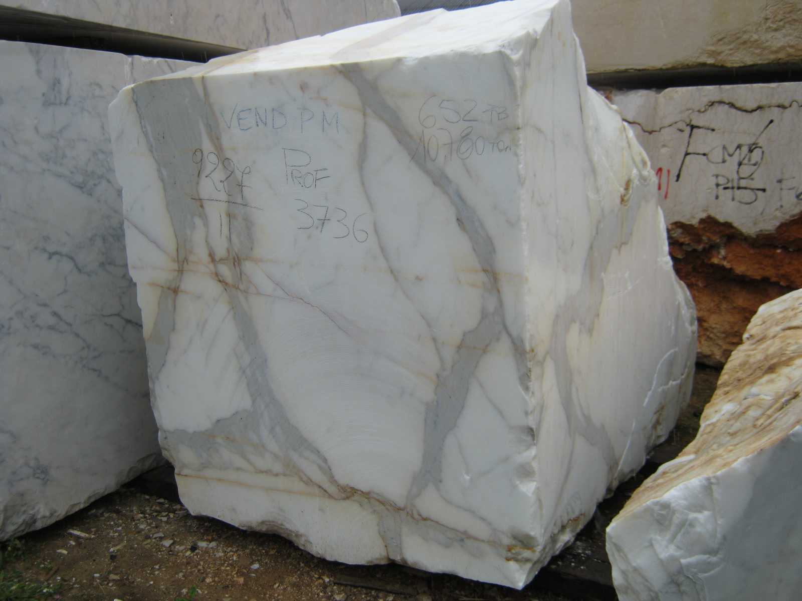
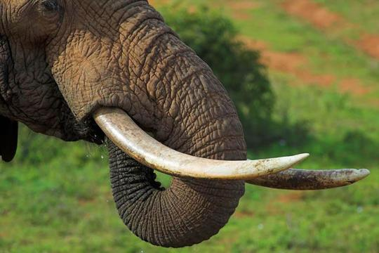
Rare Commodities on the “Manifest”

Slide 10
Warm-Up to Judgment in Ezekiel 27
Quality of Tyre’s Merchandise:
¹² Tarshish traded silver, iron, tin, and lead to Tyre
¹³ Javan, Tubal, and Meshech, traded men and vessels of brass
¹⁴ Togarmah traded horses, war-horses, and mules.
¹⁵ Dedan brought horns of ivory and ebony.
¹⁶ Syria traded emeralds, purple, fine linen, coral, and rubies.
¹⁷ Judah-Israel, traded wheat, pannag, honey, oil, and balm.
¹⁸ Damascus with the wine of Helbon, and white wool.
¹⁹ Vedan and Javan traded yarn, bright iron, cassia, and calamus
²⁰ Dedan -- precious cloths for riding.
²¹ Arabia, and Kedar -- in lambs, and rams, and goats
²² Sheba and Raamah used spices, precious stones, and gold.
²³ Haran and Canneh and Eden -- wrappings of blue and broidered work, and in chests of rich apparel, bound with cords and made of cedar, among thy merchandise.
Quality of Tyre’s ships:
⁵ They have made all thy planks of fir-trees from Senir; they have taken a cedar from Lebanon to make a mast for thee. ⁶ Of the oaks of Bashan have they made thine oars; they have made thy benches of ivory inlaid in boxwood, from the isles of Kittim. ⁷ Of fine linen with broidered work from Egypt was thy sail, that it might be to thee for an ensign; blue and purple from the isles of Elishah was thine awning. ⁸ The inhabitants of Sidon and Arvad were thy rowers: thy wise men, O Tyre, were in thee, they were thy pilots. (ASV)

Slide 11
Rome’s Trade Compared to Tyre’s

Slide 12
Serious Judgment

Slide 13
Millstones from Galilee

Slide 14
Why, Why, and Why!

Slide 15
The END of the Beginning

Slide 17
Title and Content Layout with List
Add your first bullet point here
Add your second bullet point here
Add your third bullet point here

Slide 18
Testament of Judah 13
1 And now I command you, my children, hearken to Judah your father, and keep my sayings to perform all the ordinances of the Lord, and to obey the commands of God. 2 And walk not after your lusts, nor in the imaginations of your thoughts in haughtiness of heart; and glory not in the deeds and strength of your youth, for this also is evil in the eyes of the Lord. 3 Since I also gloried that in wars no comely woman's face ever enticed me, and reproved Reuben my brother concerning Bilhah, the wife of my father, the spirits of jealousy and of fornication arrayed themselves against me, until I lay with Bathshua the Canaanite, and Tamar, who was espoused to my sons. 4 For I said to my father-in-law: I will take counsel with my father, and so will I take thy daughter. And he was unwilling, but he showed me a boundless store of gold in his daughter's behalf; for he was a king. 5 And he adorned her with gold and pearls, and caused her to pour out wine for us at the feast with the beauty of women. 6 And the wine turned aside my eyes, and pleasure blinded my heart. 7 And I became enamored of and I lay with her, and transgressed the commandment of the Lord and the commandment of my fathers, and I took her to wife. 8 And the Lord rewarded me according to the
imagination of my heart, inasmuch as I had no joy in her children.

Slide 19
Title and Content Layout with Chart

Slide 20
Two Content Layout with Table
First bullet point here
Second bullet point here
Third bullet point here
Class | Group A | Group B
Class 1 | 82 | 95
Class 2 | 76 | 88
Class 3 | 84 | 90

Slide 21
Two Content Layout with SmartArt
First bullet point here
Second bullet point here
Third bullet point here
Group A
Task 1
Task 2
Group B
Task 1
Task 2
Task 3
Task 4
Task 3

Slide 22
Add a Slide Title - 1

Slide 23
Add a Slide Title - 2

Slide 24
Add a Slide Title - 3

Slide 26
Add a Slide Title - 4

Slide 27
Add a Slide Title - 5

