Slide 1
Good Friday Worship Grace Chinese Christian Church 耶稣受难日敬拜 基 督 教 懷 恩 堂
The Seven Last Sayings of Jesus 耶稣最后的七句话

Slide 2
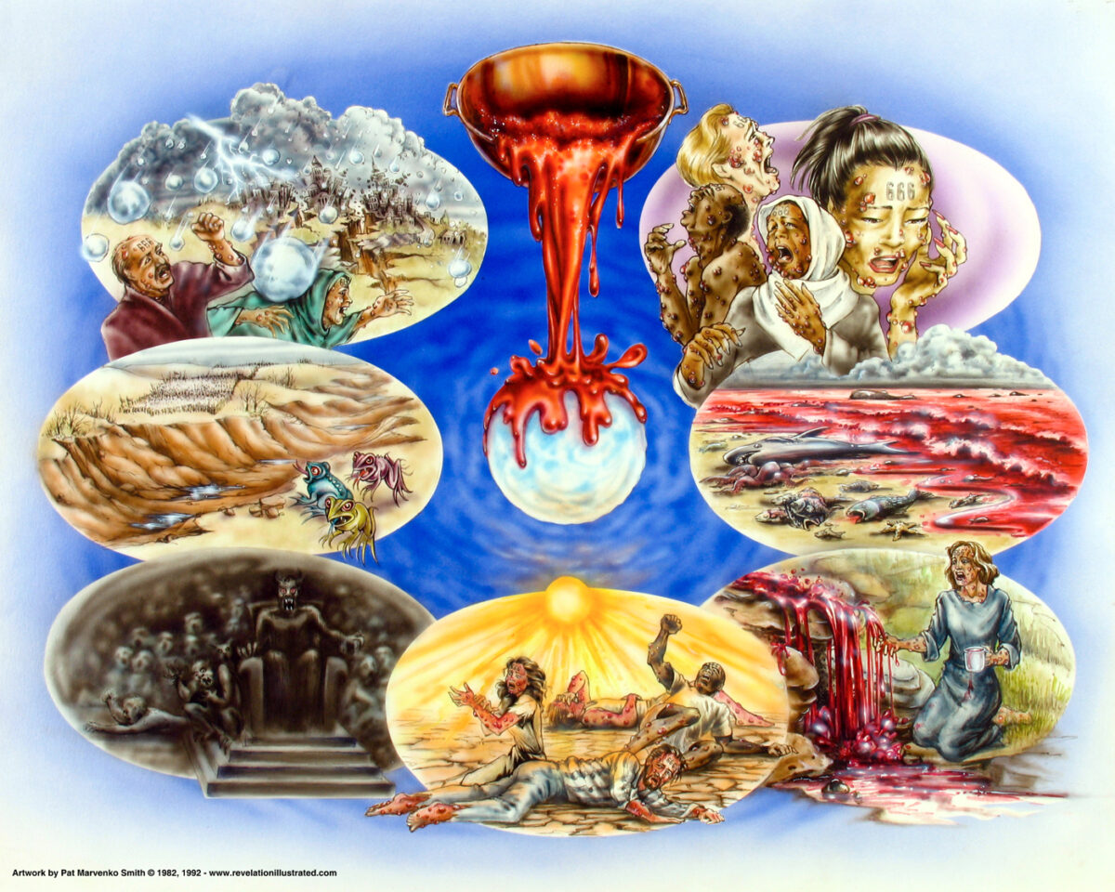
Ever Notice The # in the Bible? 你有注意圣经中 的个数嗎？
7
7

Slide 3
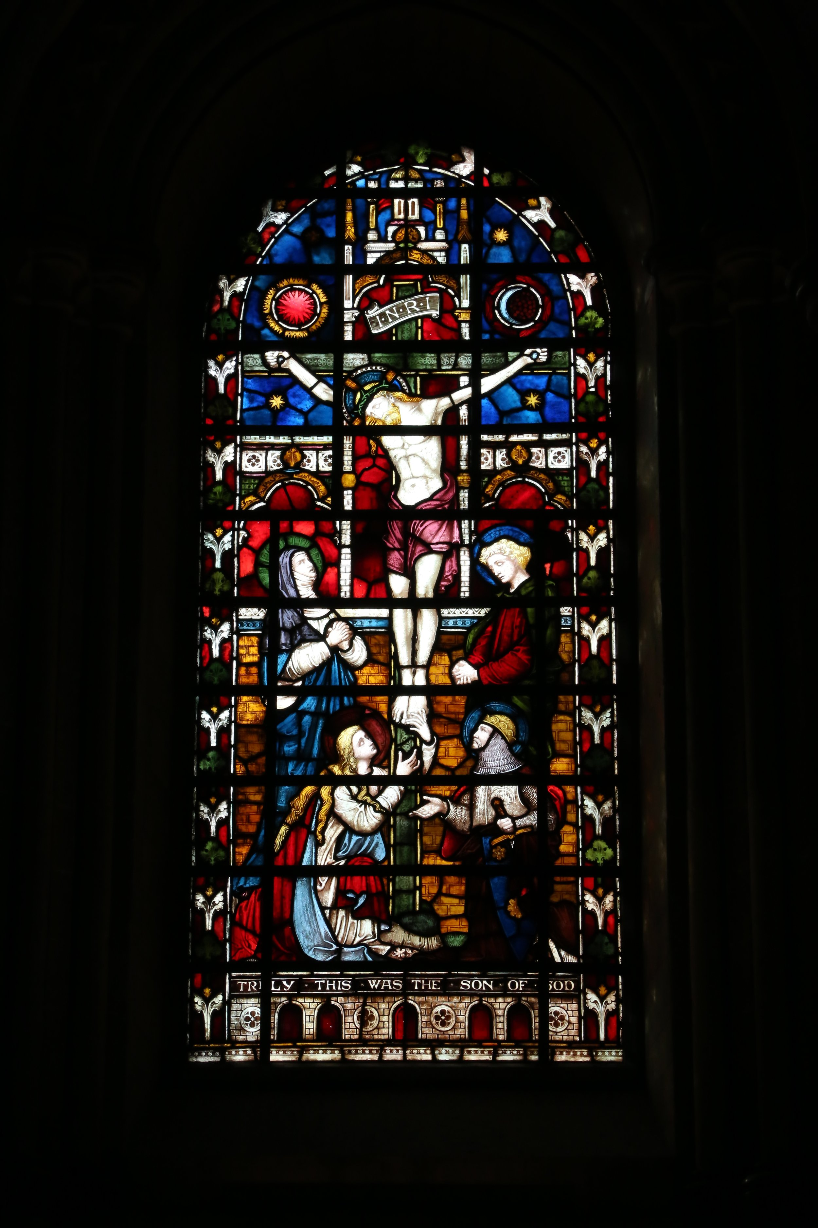
Windows / 个窗户
7
7

Slide 4
Leaves of the Vine / 片葡萄樹叶
7
7

Slide 5
Rungs, Links / 横档, 链接
7
7

Slide 6
Opening Prayer: Dr. Philip Wong and Ginny Ching Yin Lo

Slide 7
They bound the hands of Jesus in the garden where He prayed; 在主祷告的园子里，他们捆绑主的手，

Slide 8
They led Him thro' the streets in shame. 他们带祂游街受辱，
They said, "Crucify Him; He's to blame."
说祂有罪要钉祂十架。
They spat upon the Savior, so pure and free from sin. 他们朝他吐口水，圣洁无罪的救主，

Slide 9
He could have called 10,000 angels 祂可求父差千万天使，
To destroy the world
毁灭这世界，
And set Him free!
将祂释放；
He could have called 10,000 angels
祂可求父差千万天使，
But He died alone for you and me!
祂竟愿受死， 为你为我。

Slide 10
Upon His precious head, they placed a crown of thorns, 在主极尊贵的头上，被戴上荆棘冠冕；
They laughed and said, “Behold, the King!”
戏笑祂说“看哪！这王。
They struck Him and they cursed Him,
”被他们鞭打辱骂，
And they mocked His holy name,
又嘲笑祂的圣名，
All alone, He suffered everything.
祂独自忍受一切顶撞。

Slide 11
He could have called 10,000 angels 祂可求父差千万天使，
To destroy the world
毁灭这世界，
And set Him free!
将祂释放；
He could have called 10,000 angels
祂可求父差千万天使，
But He died alone for you and me!
祂竟愿受死， 为你为我。

Slide 13
Die Sieben Worte Jesu Christi am Kreuz The Seven Sayings of Jesus on the Cross 耶稣在十字架上的最后七句话
Da Jesus an dem Kreuze stund,
Jesus stood on the cross,
耶稣站在十字架上
Und ihm sein Leichnam war verwundt,
and His body was wounded,
他的身体受伤了

Slide 14
Da Jesus an dem Kreuze stund,
Jesus stood on the cross,
耶稣站在十字架上
Und ihm sein Leichnam war verwundt,
and His body was wounded,
他的身体受伤了
So gar mit bitterm Schmerzen
So much bitter pain,
如此痛苦
So gar mit bitterm Schmerzen
So much bitter pain,
如此痛苦

Slide 15
die sieben Wort, die Jesus sprach
Jesus said seven sayings (“words”)
耶稣说了七句话
Betracht in deinem Herzen
Contemplate them in your heart,
在你的心中思考它们

Slide 16
die sieben Wort, die Jesus sprach
Jesus said seven sayings (“words”)
耶稣说了七句话
Betracht in deinem Herzen
Contemplate them in your heart,
在你的心中思考它们

Slide 17
Christ for Others / 基督为他人
“Jesus said, ‘Father, forgive them, for they don’t know what they’re doing.’ They drew lots as a way of dividing up his clothing.” Luke 23:34 [CEB]
³⁴ 耶穌說：“父啊，赦免他們！因為他們不知道自己所作的是甚麼。”士兵抽籤，分了他的衣服。 路加福音 23:34 [新譯本]

Slide 18
Die Dritte Stunde The Third Hour 第三个小时
Und es war um die dritte Stunde, And it was the third hour, 现在是第三个小时
da sie Jesum kreuzigten that Jesus was crucified 耶稣被钉十字架
er aber sprach: but He spoke: 但他说话了

Slide 19
Intercession / 代求
Vater, Vater, Vater, vergieb ihnen, Father, Father, Father forgive them 父亲, 父亲, 父亲，原谅他们
Den sie Wissen nicht, den sie Wissen nicht, was sie thun.” Because they know not, 因为他们不知道
Wissen nicht, was sie thun.”
they know not what they do.” 因为他们不知道他们做什么

Slide 20
Thoughtfulness / 体贴
²⁶ 耶穌看見母親， 又看見他所愛的那門徒站在旁邊， 就對母親說：“母親 (“母親”原文作“婦人”）， 看！你的兒子。” ²⁷ 然後他對那門徒說： “看！你的母親。”從那時起， 那門徒就把她接到自己的家裡去了。
²⁶ When Jesus saw his mother and the disciple whom he loved standing nearby, he said to his mother, “Woman, here is your son.” ²⁷ Then he said to the disciple, “Here is your
mother.” And from that time on, this disciple took her into his home.

Slide 21
Women at the Cross 妇女看到十字架
Es stund aber bei dem Kreuze, Jesu seine Mutter,
But there was beside the cross, Jesus’ mother,
但在十字架旁边是耶稣的母亲
Und seiner Mutter Schwester, Maria, Cleophas Weib,
His mother’s sister, Mary, a woman Cleophas,
他母亲的妹妹和一个女人，克里奥法
Und Maria Magdalena. And Mary Magdalene.
和抹大拉的马利亚

Slide 22
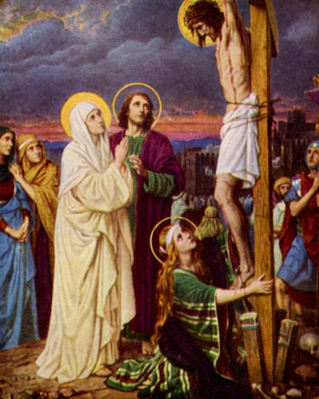
Da nun Jesus seine Mutter sahe,
Then, Jesus saw His mother
然后耶稣看见了他的母亲
Und den Jünger dar bei stehen, den er lieb hatte,
and the disciple whom He loved standing beside her.
和他所爱的弟子 站在她旁边
Sprach er zu seiner Mutter: He said to His mother:
他对他妈妈说
“Weib, Weib siehe, das ist dein Sohn, dein Sohn.”
“Woman, woman see, this is your son, your son.”
女人，女人，这是你的儿子

Slide 23
Darnach spricth er zu dem Jünger: Afterwards, He spoke to the disciple:
然后他对门徒说
Johannes, Johannes, siehe, das ist deine Mutter
“John, John, see, this is your mother.”
约翰，约翰，看，这是你妈妈
Und von Stund an nahm sie der Jünger zu sich
And from that hour, she took the disciple for herself.
从那时起，她就把他当作自己的儿子

Slide 24
The Thief on the Left 左边的强盗
Aber der Übelthater einer die da gehenkt waren,
But one of the offenders who was hanging there with Him
但是和他一起吊死的强盗之一
Lästert ihn und sprach:
Blasphemed Him and said:
亵渎他并说

Slide 25
Bist du Christus, bist du Christus,
Are you the Christ? Are you the Christ?
你是基督吗？你是基督吗？
Bist du Christus, so hilf dir selbst,
Are you the Christ? Then, save yourself.
若是基督就救自己
Dir selbst und uns.
Yourself and us.
並救我们

Slide 26
Da antwortete der ander, strafte ihn und sprach:
The other [offender] answered, rebuking him and said:
另一个强盗回答, 斥责他说
Und du, und du fürchtest dich auch nicht für Gott,
“And you, and you, do you also not fear God?
而你，也不當怕上帝?
Der du doch in glei, cher Verdammniss bist,
Who is in the same damnation,
你在同样的诅咒中

Slide 27
Und zwar wir sind billig darinnen,
though we are fairly in it,
虽然这对我们很公平
den wir empfangen was unsere Thaten werth sind,
And we are receiving what our deeds are worth,
我们正在接受我们的行为所值得的
Dieser aber, dieser aber hat nichts ungeschicktes gehan delt.
But He, But He has not acted inappropriately.
但他没有不当行为

Slide 28
Und sprach zu Jesu: And he said to Jesus:
他对耶稣说
“Herr gedenke an mich, Herr, gedenke an mich, Herr gedenke an mich
“Sir, think of me, Sir think of me, Sir, think of me
主啊，记念我, 主啊，记念我, 主啊，记念我
Wenn du in dem Reich kommst.”
When You come into [Your] kingdom.”
当你进入你的王国

Slide 29
Und Jesu sprach: And Jesus said:
於是耶稣说
Wahrlich ich sage dir, heute wirst du mit mir im Paradies sein, im Paradies sein.
“Certainly, I say to you, today you will be with Me in Paradise, in Paradise.”
当然，我告诉你, 今天你会和我一起在樂園

Slide 30
Luke 23:43 [CEB] 路加福音 23:43 [新譯本]
⁴³ Jesus replied, “I assure you that today you will be with me in paradise.”
⁴³ 耶穌對他說： “我實在告訴你， 今天你必定同我在樂園裡了。”

Slide 31
Quoting Psalm 22 引用诗篇 22
Und um die neunte Stunde, de Schrei Jesus laut,
And in the ninth hour, Jesus shouted loudly,
在第九个小时, 耶稣大喊
Schrei Jesus laut und sprach:
Jesus shouted loudly and said:
耶稣大喊, 他说
Das ist verdolmetschet: Which is translated: 可翻译为
“Mein Gott, mein Gott,” My God, My God,” 我的神,我的神
“warum has du mich verlassen?” “why have You abandoned Me?” 你为什么离弃我？
“Eli, Eli, Eli lama sabthani,
“Eli, Eli, Eli lama sabthani,
以利，以利， 拉馬撒巴各大尼

Slide 32
马太福音 27:46 [新譯本] Matthew 27:46 [CEB]
⁴⁶ 大約三點鐘，耶穌大聲呼叫：“以利，以利， 拉馬撒巴各大尼？”意思是“我的 神，我的 神，你為甚麼離棄我？”
⁴⁶ At about three Jesus cried out with a loud shout, “Eli, Eli, lama sabachthani,” which means, “My God, my God, why have you left me?”

Slide 33
John 19:28-29 [CEB] 约翰福音 19:28-29 [新譯本]
²⁸ 這事以後，耶穌知道一切都已經成就了， 為了要使經上的話應驗，就說：“我 渴了，他們就拿海綿浸了酸酒， 綁在牛膝草上，送到他的口裡。
²⁸ After this, knowing that everything was already completed, in order to fulfill the scripture, Jesus said, “I am thirsty.” 29 A jar full of sour wine was nearby, so the soldiers soaked a sponge in it, placed it on a hyssop branch, and held it up to his lips.

Slide 34
Completed / Fulfilled 已完成 / 履行
³⁰ 耶穌嘗了那酸酒，說：“成了！”就低下頭， 斷了氣。 约翰福音 19:30 [新譯本]
30 When he had received the sour wine, Jesus said, “It is completed.” Bowing his head, he gave up his life. John 19:30 [CEB]

Slide 35
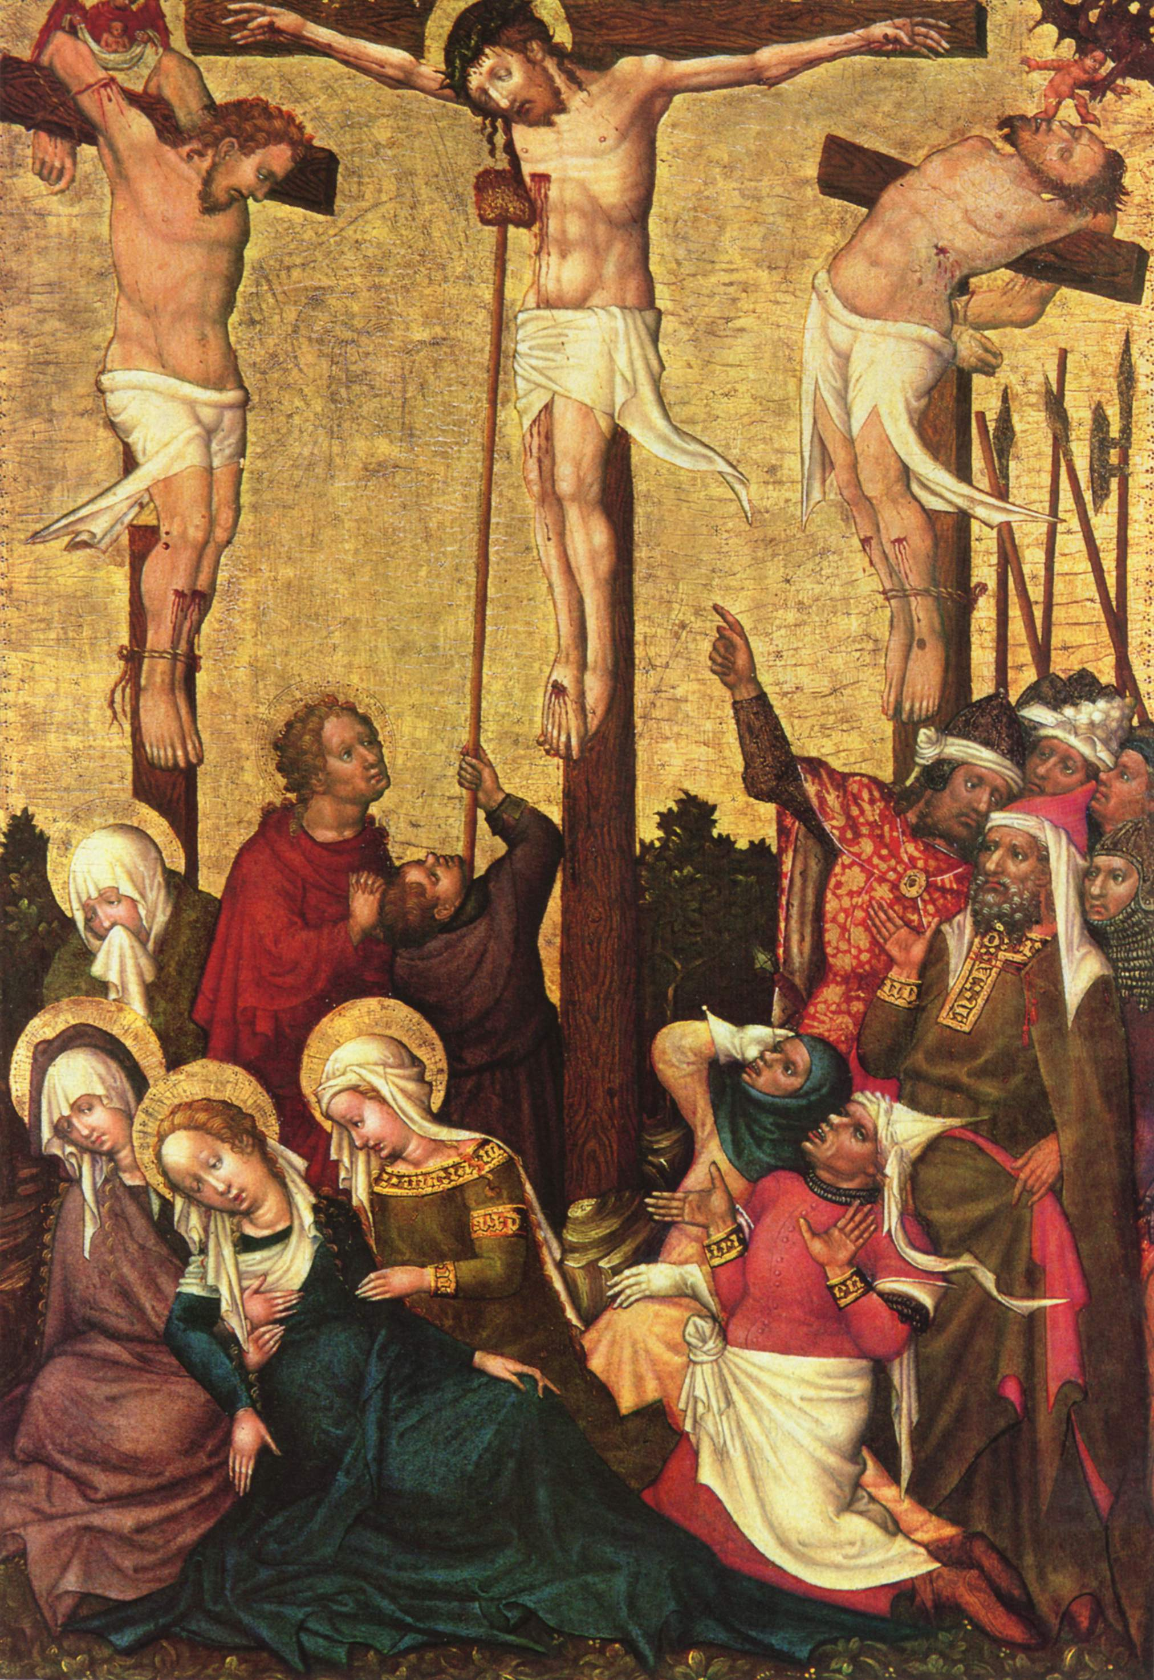
Darnach als Jesus wusste, dass schon alles Vollbracht war,
Afterward, as Jesus knew, everything was done,
后来，正如耶稣所知道的， 一切都完成了
Alles Vollbracht war Dass die Schrift erfüllet würde,
Everything was done that the Scripture would be fulfilled,
一切都已完成，因此圣经将得到应验
Sprach er: He said: 他说
“Mich dürstet!” “I am thirsty!” 我渴了

Slide 36
Und einer aus den Kriegesknechten life bald hin,
And one of the soldiers ran by there,
一名士兵跑过
Einene Schwamm und füllet ihn mit Essig und Ysopen
Took a sponge and filled it with vinegar and hyssop,
用酸酒和牛膝草填充海绵
Und stecket ihn auf ein Rohr und hielt ihn dar zum Munde und tränket ihn.
And stuck it on a pole and held it to [His]mouth and He drank.
把它插在一根杆子上，放到他的嘴里，他喝了
Da nun Jesus den Essig genommen hatte, spracher:
Then, Jesus knowing it was vinegar, said: 耶稣知道那是醋说：
Es ist Vollbracht, es ist Vollbracht. “It is done! It is done!” “完成了。完成了。”

Slide 37
路加福音 23:46 [新譯本] Luke 23:46 [CEB]
⁴⁶ 耶穌大聲呼叫：“父啊，我把我的靈魂交在你手裡。”說了這話，氣就斷了。
⁴⁶ Crying out in a loud voice, Jesus said, “Father, into your hands I entrust my life.” After he said this, he breathed for the last time.

Slide 38
Und abermal rief Jesus laut,
And Jesus cried out again:
耶稣又大声喊叫
“Vater, Vater, Vater, Vater,
“Father, Father, Father, Father,
“父亲，父亲，父亲，父亲
Ich befehle meinen Geist in deine Hände, in deine Hände.”
I order My spirit into Your hands, into Your hands.”
我命令我的灵魂交在你手中”

Slide 39
Und als er das gesagt hatte, neiget, neiget er das Haupt
And as He said this, He tilted, He tilted His head
说这话的时候，他歪了歪头
Und gab seinen Geist auf, und gab seinen Geist auf
And gave up His spirit, and gave up His spirit.
并交出他的灵魂, 并交出他的灵魂

Slide 40
Wer, wer Gottes Marter in Ehren hat / Who has honor in God’s suffering
谁在上帝的折磨中找到荣耀
Und oft gedenkt er Sieben Wort, / & often contemplates the seven sayings,
时常思惟七言
Wer, wer Gottes Marter in Ehren hat / Who has honor in God’s suffering
谁在上帝的折磨中找到荣耀
Und oft gedenkt er Sieben Wort, / & often contemplates the seven sayings,
时常思惟七言
Und oft gedenkt er Sieben Wort, Und oft gedenkt er Sieben Wort,
And often contemplates, often contemplates the seven sayings,
时常思惟七言, 时常思惟七言

Slide 41
Des will Gott gar eben pflegen
God wants to care for you,
上帝想要照顾你
Wohl hie auf Erden mit seiner Gnad
Probably here on Earth with His grace
可能在地球上赐他的恩典
Und dort in dem ewigen Leben
And there in eternal life.
还有 在永生中
Wohl hie auf Erden mit seiner Gnad
Probably here on Earth with His grace,
可能在地球上赐他的恩典
Und dort in dem ewigen Leben
And there in eternal life,
还有 在永生中

Slide 42
7 Lessons / 7 教训
1. Forgive others / 原谅别人
2. Care for physical and emotional needs of others / 照顾别人
3. Jesus is the only sure way to salvation / 耶稣是唯一的得救之道
4. Remember that even when we feel abandoned, God still has a plan for us. / 即使我们感到被遗弃，上帝也有计划
5. Remember that even when doing God’s will, we may need to suffer. / 即使遵行上帝的旨意，我们也可能会受苦
6. Trust God to make even death meaningful. 神甚至使死亡有意义
7. Remember to submit to God, even when things look hopeless. 即使看起来毫无希望，也要顺服上帝

Slide 43
