Slide 1
A Vision of Heaven
Revelation 4

Slide 2
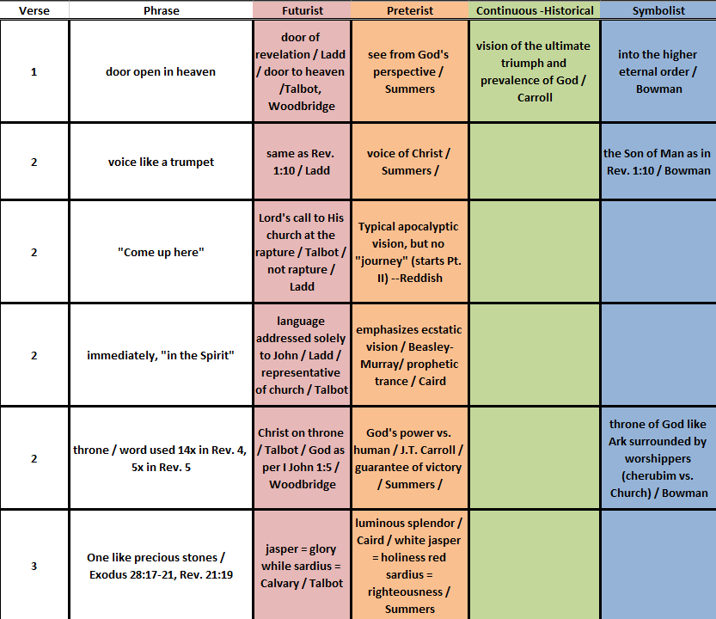
Setting the
Stage

Slide 3
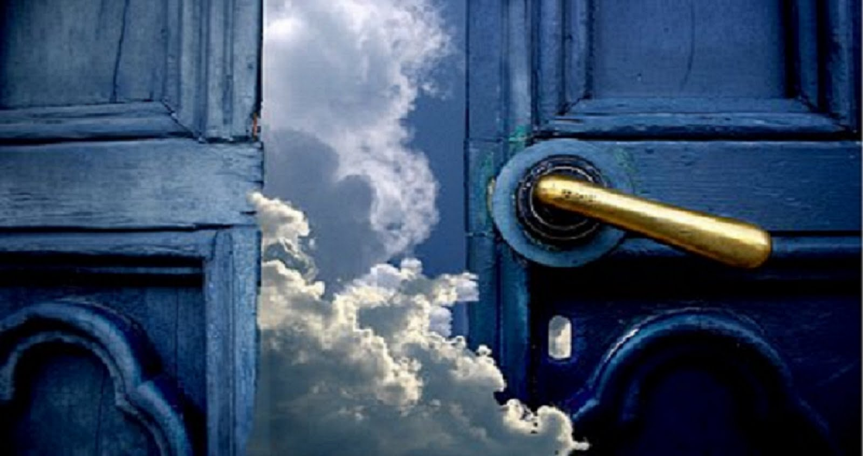
Door in Heaven
Curtain rolled back? = Ezekiel 1
A portal? = I Enoch 14:8, 15

Slide 4
Could This Be “The Rapture?”
Could this be the fulfillment of 1 Thessalonians 4:14-17?
Could this be the fulfillment of Matthew 24:4-25:46?
Jesus will bring (back) departed when He comes (v. 14)
Those alive have no precedence (v. 15)
Lord descends from heaven with shout, trumpet voice (v. 16)
“Snatched” up to meet Him in the air (v. 17)
To be with HIM forever (v. 17)
Don’t buy into the false “Messiah” (24:4-8)
Persecution, war, famine, and false prophets (24:9-14)
Abomination, false “Messiah”s (24:15-28)
Clouds and glory, gathering chosen (24:29-51)
Parables on staying faithful (25:1-30)
Final Judgment (25:31-46)

Slide 5
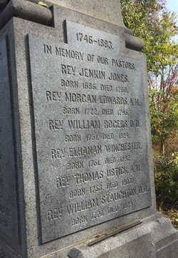
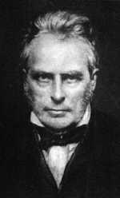
So Where Did The Idea Originate?
Morgan Edwards
1788
John Nelson Darby
1830
Thought Rev. 20
represented a
secret rapture!
Treated as error
Not until 1830 had
any church believed
or taught this as a
basic doctrine.

Slide 6
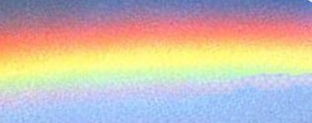
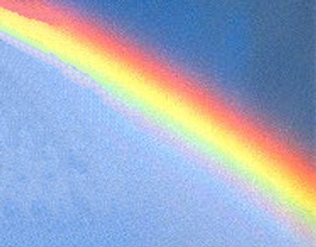
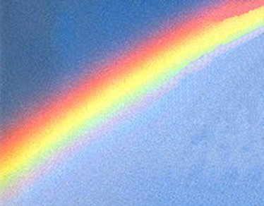
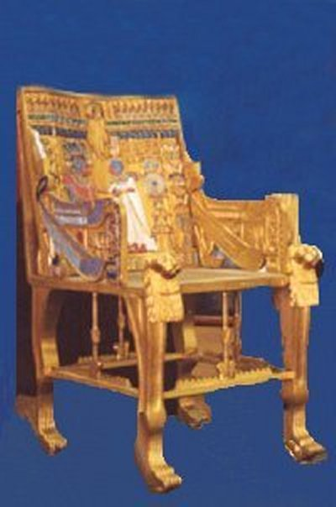
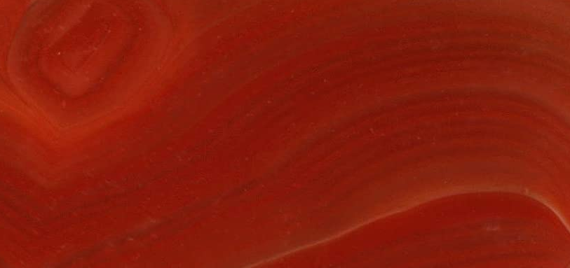

The Eternal Present
The rainbow reminds us of God’s covenant
with Noah – grace over judgment!
Carnelian
Associated
with “Charity”
Jasper
Associated
with “Faith” /
holiness
God can only be seen in the facets of His
love and revelation as grasped by faith!

Slide 7
B. H. Carroll Sermon (19th c.)
“First of all he saw a throne. We know it to be the throne of grace by the rainbow arch above it. On that throne, whether described by Isaiah, Ezekiel, or John, the Almighty is presented in an exceedingly reticent way. No man has seen God directly at any time, nor can see him. He said to Moses: “You. saw no image.” So here the Father appears without form or shape – vaguely seen as the brilliance of a jewel.”

Slide 8
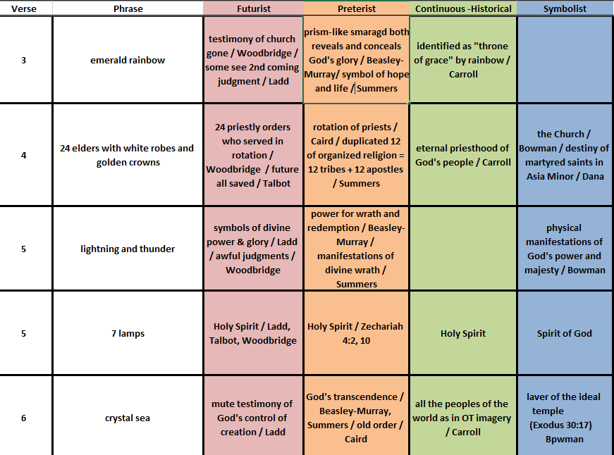
Glimpses of the Throne

Slide 9
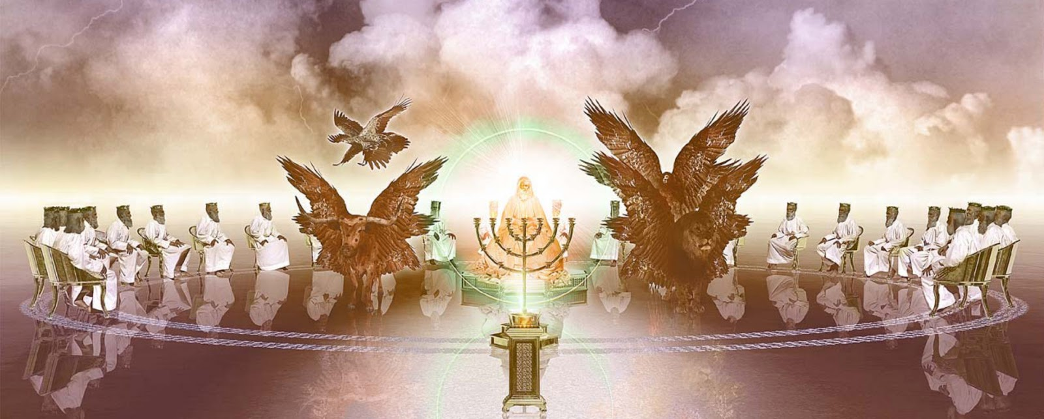
God’s Consistent Plan
24 Thrones
12 Thrones?
12 Thrones?
12 heads of
tribes?
12 apostles?
24 thrones MAY refer to 24 priests as found in
I Chronicles 24:4 or to Old + New Covenants!

Slide 10
Important Symbolism
Sea of Glass represents stability and calm instead of chaos usually seen in sea
Lion creature represents wild animals
Ox creature represents domestic animals
Human creature represents humankind
Eagle creature represents birds
Eyes equal ceaseless vigilance/intelligence
Wings represent swiftness of movement

Slide 11
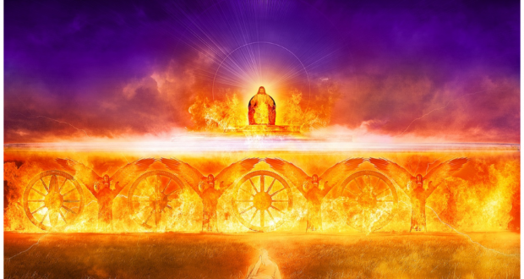
God’s Judgment
7 Spirits
Totality of God
Fire purifies,
tempers, destroys

Slide 12
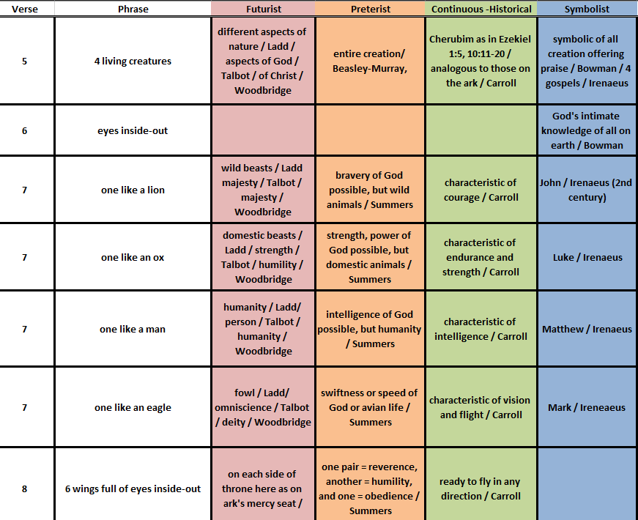
Glimpses of the Cherubim

Slide 13
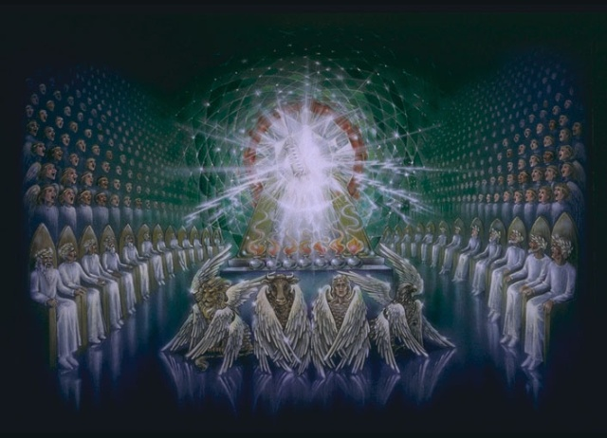
Cherubim, Throne, 24, Redeemed

Slide 14
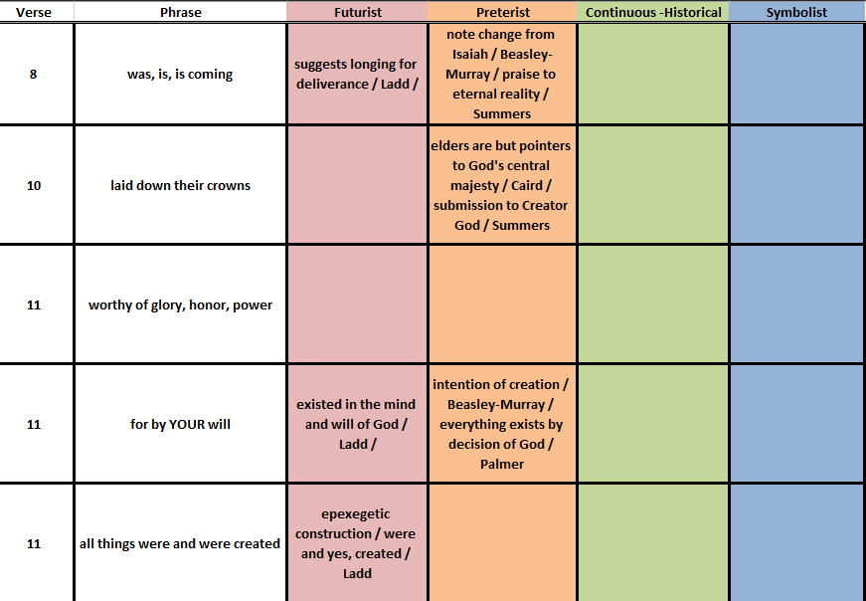
Holy
Holy
Holy

Slide 15
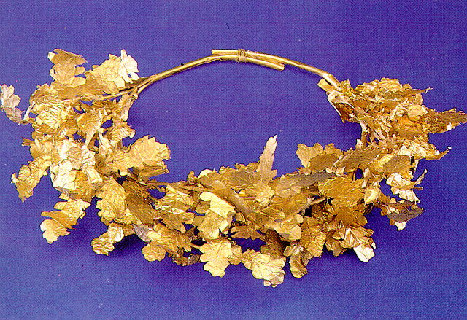
`
Earthly authority and privilege removed in virtue of God’s ultimate authority
“Our Lord and our God” places God in the
Place of Domitian (Dominus et Deus Noster)

