Slide 2
Relationships?
Is there are relationship between Matthew 24 and Revelation 6?
YES! Matthew 24:29 is the same symbolism/events as Revelation 6:13
AND takes place before the symbolism events of Rev. 19:11-16
WHICH IS BEFORE Revelation 20:4-6, 12-15 equivalent to the gathering in Matthew 24:30-31 and 1 Thessalonians 4:15-18
WHICH IS in agreement with 1 Corinthians 15:24-27, 51-53

Slide 3
Heaven and Earth 2.0

Slide 4
Radical Reset

Slide 5
Isaiah’s 66:13, 22
13) “As a mother comforts her child, so I will comfort you: in Jerusalem you will be comforted.”
22) “As the new heavens and the new earth that I’m making will endure before me, says the Lord, so you descendants and your name will endure.”

Slide 6
Sea = Chaos, Erosion, Threat, but… …consider this …
John was on the Island of Patmos. WHAT separated him from the churches and Christian fellowship?

Slide 7
And Why Is There No Sea?
“But the wicked are like a troubled sea, a sea that cannot rest, whose troubled waters cast up mud and filth.” Isaiah 57:20 NEB
“…sending you down to the pit to die, a death of disgrace on the high seas.” Ezekiel 28:8

Slide 9
Why Jerusalem? Joel 2:32
32) “But everyone who calls on the Lord’s name will be saved; for on Mount Zion and in Jerusalem there will be security, as the Lord has promised; and in Jerusalem, the Lord will summon those who survive.”

Slide 10
Why Jerusalem? Psalms 14:7
7) “Let Israel’s salvation come out of Zion! When the Lord changes his people’s circumstances for the better, Jacob will rejoice; Israel will celebrate!”

Slide 11
A Bride Perfectly Dressed

Slide 12
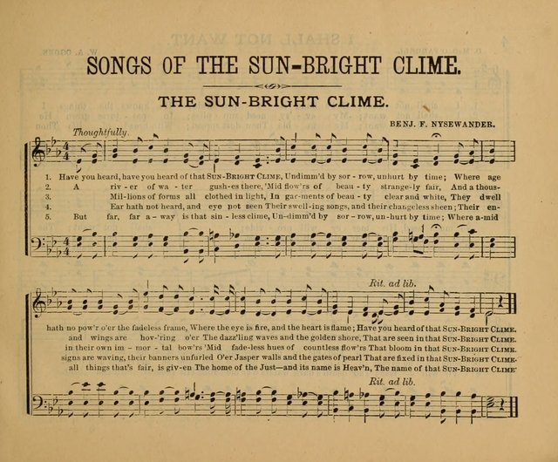
Tent Revival Hymn
Have you heard, have you heard of that sun-bright clime,
Undimmed by sorrow and unhurt by time;
Where age hath no power o’er fadeless frame:
Where the eye is fire, and the heart is flame;
Have you heard of that sun-bright clime?

Slide 13
Word from the Throne
God is now LIVING with humanity “accommodates to our inadequacy” “allows proximity and access”
God’s presence guarantees comfort (no need for tears)
God’s presence guarantees life (no need for death)
God’s presence guarantees optimism (no grief/laments)
God’s presence guarantees meaning (no drudgery)

Slide 14
First Glimpse of God’s Promised Presence

Slide 15
“The tops of the wall are laid out in twelve traffic lanes—and no guard rails. …Even with all twelve gates in use and dozens of Peter-deputized clerks at each gate and examination waived (since we all were caught up in the Rapture—guaranteed saved) we had to queue up quite a long time just to get registered in, receive temporary identifications, …” (p. 236)

Slide 16
10x Higher and ca. 100x Wider!

Slide 17
Measurements of the Holy City

Slide 18
New and Improved?
12 Gates of Pearls
Chrysolite
Jasper
Beryl
Sapphire
Topaz
Chalcedony
Emerald
Chrysoprase
Jacinth
Sardonyx
Amethyst
Carnelian

Slide 19
Concepts of the City

Slide 20
Wrong Direction (v. 8)

