Slide 1
No “Red wedding” The victory banquet
Revelation 19:1-21
Notes:
NOTE:
To change the image on this slide, select the picture and delete it. Then click the Pictures icon in the placeholder to insert your own image.

Slide 2
The Infamous “Red Wedding” in Game of Thrones
Except for those of us who had read the books, no one was expecting the blood bath that the royal wedding in Game of Thrones became the “Red Wedding.”
Rob Stark and his bride, Talisa Stark (nee’ Maegyr), are brutally assassinated by a traitor (resentful that Rob is not marrying his daughter) and giving temporary victory to a cruel, narcissistic king named Joffrey. It looks like evil wins, but Joffrey himself is killed at his “Purple Wedding.”

Slide 3
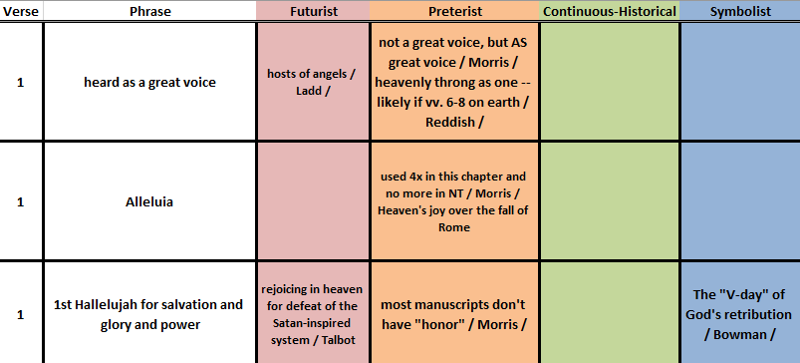
Seeds of the Hallelujah Chorus

Slide 4
A Children’s Chorus (from mid-20th century)
Children’s Chorus
Literal Meaning
Hallelu, hallelu, hallelu, hallelujah!
Praise ye, the Lord!
Hallelu, hallelu, hallelu, hallelujah!
Praise ye, the Lord!
Praise ye the Lord! Hallelujah!
Praise ye the Lord! Hallelujah!
Praise ye the Lord! Hallelujah!
Praise ye the Lord!
Praise, praise, praise, praise Yah(weh)
All of you praise the Lord!
Praise, praise, praise, praise Yah(weh)
All of you praise the Lord!
All of you praise the Lord! Praise Yah(weh)!
All of you praise the Lord! Praise Yah(weh)!
All of you praise the Lord! Praise Yah(weh)!
All of you praise the Lord!

Slide 5
A Fair and Proper Judgment

Slide 6
“The destruction pictured in the fall of Rome was great. But no greater than would have been the destruction wrought by godless nations and men and women allowed to proceed unchallenged and unhindered along the roads of cruelty, degeneracy, and persecution of the righteous people of God.” Summers, Ray. Worthy Is the Lamb (p. 195). B&H Publishing Group.

Slide 7
Praise as Vital to God’s Kingdom

Slide 8
For The Lord God Omnipotent Reigneth

Slide 9
Blessed Invitation

Slide 10
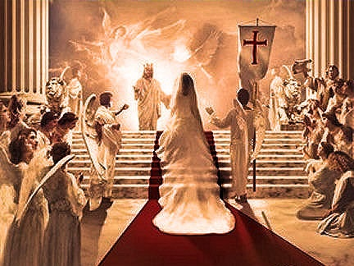
Strange Ideas About the Marriage Feast
A special reward for church members of churches which have held certain points of doctrine and praxis [Landmark Baptists, for one]
A real marriage that the apostle Paul would perform the ceremony because he had so much to do with the betrothal.
How can the church be both the bride and the attendees?

Slide 11
The Five (5) Blessings in the Book of Revelation
Revelation 1:3 – those who read, hear, and live according to this prophecy
Revelation 14:13 – those who die in the Lord going forward
Revelation 19:9 – those invited to the Marriage Banquet of the Lamb
Revelation 20:6 – those who participate in the first resurrection
Revelation 22:7 – the one who lives according to the prophecy in this book

Slide 12
Two Women / Two Lifestyles / Two Value Systems
The Great Harlot (Chapter 16)
The Virgin Bride (Chapter 19)

Slide 13
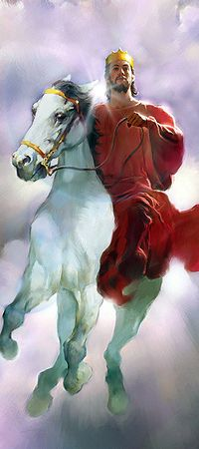
Hail, the REAL Thing!

Slide 14
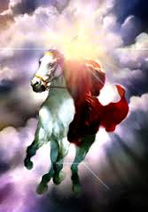
The King Prepares for War

Slide 15
Feast of Fire, Carrion, and Judgment

Slide 16
Elizabeth Schüssler Fiorenza (Harvard Divinity)
Dragon (Ch. 12)
Beast from the Sea and Beast (False Prophet) from Earth (Ch. 13)
The Great Harlot (Ch. 16)
The Great Harlot (Ch. 18)
Beast and False Prophet thrown into lake of fire and sulfur (Ch. 19)
Dragon thrown into lake of fire (Ch. 20)

Slide 17
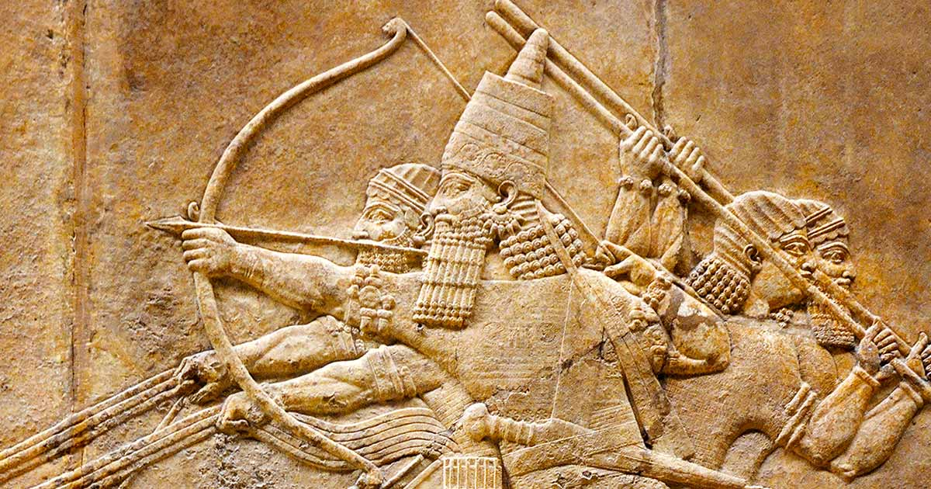
“The Death of Sennacherib” (George Gordon, Lord Byron) [Inspired by II Kings 19:35-37]
The Assyrian came down like the wolf on the fold, And his cohorts were
gleaming in purple and gold; And the sheen of their spears was like stars on
the sea, When the blue wave rolls nightly on deep Galilee.
Like the leaves of the forest when the Summer is green,
That host with their banners at sunset was seen:
Like leaves of the forest when Autumn hath blown,
That host on the morrow lay withered and strown.
For the angel of death spread his wings on the blast,
And breathed in the face of the foe as he passed;
And the eyes of the sleepers waxed deadly and chill,

Slide 18
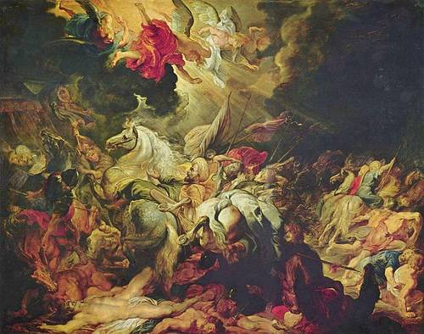
“Death of Sennacherib” [told by George Gordon, Lord Byron]
And their hearts but once heaved, and forever grew still.
And there lay the steed with his nostril all wide,
But through it there roli’d not the breath of his pride:
And the foam of his gasping lay white on the turf,
And cold as the spray of the rock-beating surf.
And there lay the rider distorted and pale,
With the dew on his brow and the rust on his mail;
And the tents were all silent, the banners alone,
The lances unlifted, the trumpets unblown.
And the widows of Ashur are loud in their wail
And the idols are broke in the temple of Baal;
And the might of the Gentile, unsmote by the sword,
Hath melted like snow in the glance of the Lord!

Slide 19
The Lessons?
If you find it hard to praise God, there’s something wrong.
Though you can praise God by yourself, there’s something very special about doing it together
God’s judgment is righteous and takes everything into perspective, such that people eventually force the judgment
We should be faithful to Christ as a virgin bride and as valued guests – how we live on the earth matters, even after we accept Christ
Though we are part of God’s armies, (hosts) the victory doesn’t depend upon us
God judges the secular culture of “Babylon” / Rome first
God judges the political-religious power structure
God judges the ultimate source of corruption, decadence, evil and rebellion

Slide 20
The end for harlot & Beasts
The Beginning of the End for the Dragon

Slide 21
Title and Content Layout with Chart

Slide 22
Two Content Layout with Table
First bullet point here
Second bullet point here
Third bullet point here
Class | Group 1 | Group 2
Class 1 | 82 | 95
Class 2 | 76 | 88
Class 3 | 84 | 90

Slide 23
Title and Content Layout with SmartArt
Step 1 Title
Task description
Task description
Task description
Task description
Step 2 Title
Task description
Task description
Task description
Step 3 Title
Task description
Task description
Step 4 Title
Task description
Task description

Slide 25
Add a Slide Title - 2

Slide 26
Add a Slide Title - 3

Slide 27
Add a Slide Title - 4

Slide 29
Add a Slide Title - 5

