Slide 1
Seven seals of Revelation 6 (Then, been, when)
Are we waiting or remembering?

Slide 2
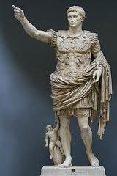
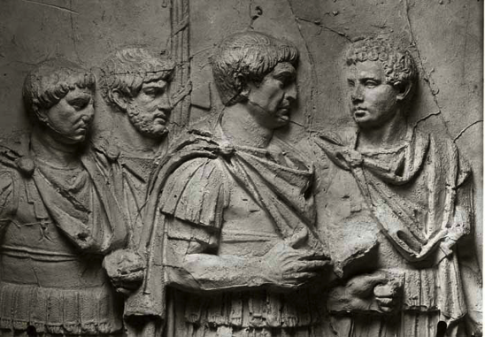
Emperors
Estimated time of John’s Imprisonment
A timeline of the Roman Emperors after Augustus (Octavian)
[27 BC-14 AD]
Augustus
[14-37]
Tiberius
[37-41]
Caligula
[41-54]
Claudius
[54-68]
Nero
[68-69]
Civil War
[68-69]
Galba
[69-69]
Ortho
[69-69]
Vitellius
[69-79]
Vespasian
[79-81]
Titus
[81-96]
Domitian
[96-98]
Nerva
[98-117]
Trajan

Slide 3
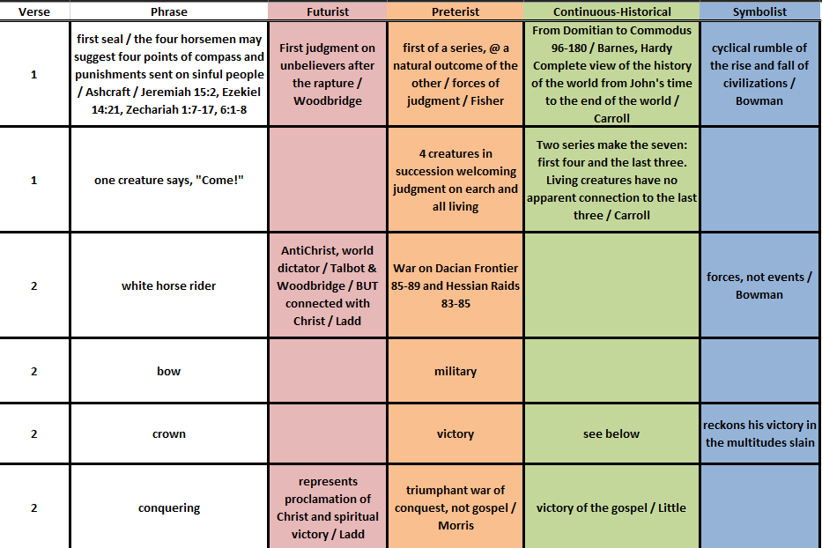
Let’s look at the text

Slide 4
Albrecht dÜrer the four horsemen of the apocalypse
Why four horses/horsemen? (satire of a horse/chariot race—Stauffer)
Zechariah 1:8-10 (Two red, one white, and a sorrel) to “patrol the earth”
Zechariah 6:1-8 (Chariots with red, black, white, and gray (?) pairs) to “patrol the earth” as four winds
White horse of conquest

Slide 5
Roman empire turn of 1st/2nd century
If John’s vision was during the time of Diocletian (end of 1st century), this shows the expanse less that two decades later.
At least, during those two decades, we see the farthest reach of the empire under Trajan.

Slide 6
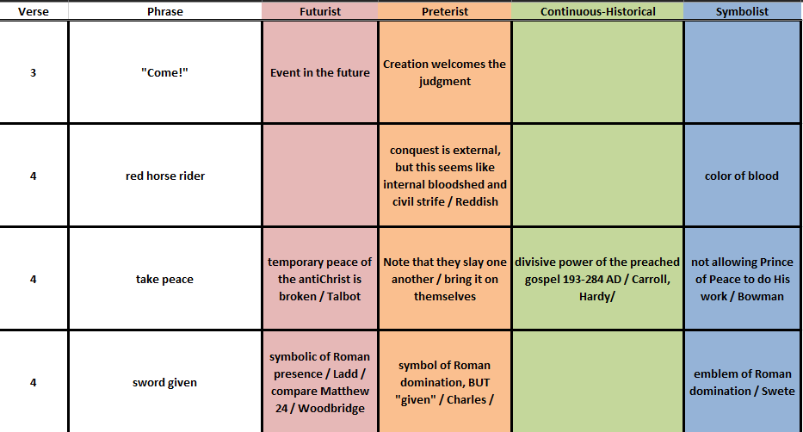
Let’s look at the text

Slide 7
Albrecht dÜrer the four horsemen of the apocalypse
White horse of conquest
Red horse takes away peace (War)
Jeremiah 15:2 “destined for pestilence to pestilence, destined for the sword, to the sword, those destined for famine, to famine, those destined for captivity to captivity” (NRSV)

Slide 8
Campaign Under domitian
In 85, Decebalus invaded from Dacia and occupied Adamklissi
Domitian marched to the Danube River
Sent Cornelius Fuscus to raid into Dacia
Where he became lost in the mountains and was defeated in 86

Slide 9
Campaign Under domitian
In 85, Decebalus invaded from Dacia and occupied Adamklissi area

Slide 10
Campaign Under domitian
In 88, Tettius Iulianis crossed the Danube at Drobeta and defeated Decebalus at first Battle of Tapae

Slide 11
Decebalus -- last king of dacia
Decebalus, the Dacian king, approved himself a rival not unworthy of Trajan ; nor did he despair of his own and the public fortune, till, by the confession of llis enemies, he had exhausted every resource both of valor and policy.18 This memorable war, with a very short suspension of hostilities, lasted five years; and as the emperor could exert, without control, the Whole force of the state, it was terminated by an absolute submission of the barbarians.¹⁷ The new province of Dacia, which formed a second exception to the precept of Augustus, was abou~ thirteen hundred miles in circumference. Its natural boundaries were the Niester, 'the Teyss or Tibiscus, the Lower Danube, and the Euxine Sea.

Slide 12
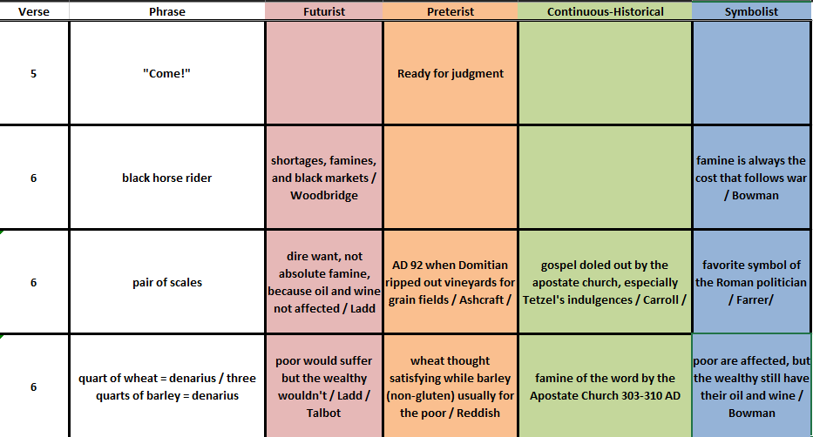
Let’s look at the text

Slide 13
Albrecht dÜrer the four horsemen of the apocalypse
White horse of conquest
Red horse takes away peace (War)
Black horse of famine
“For thus says the Lord God: How much more will I send upon Jerusalem my four deadly acts of judgment, sword, famine, wild animals, and pestilence, to cut off humans and animals from it!” (Ezekiel 14:21)

Slide 14
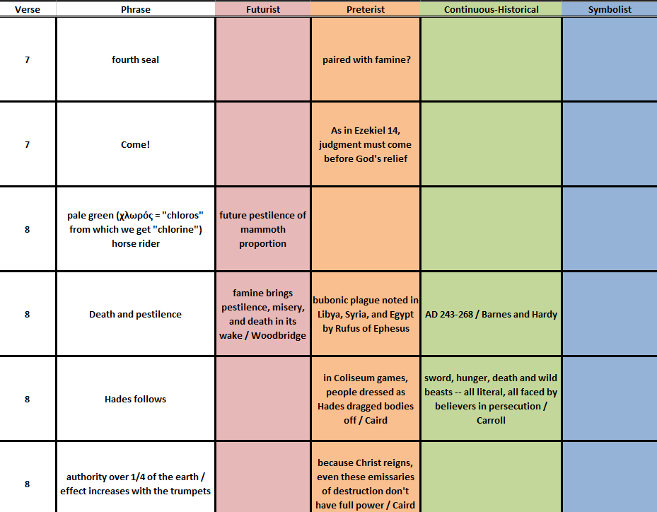
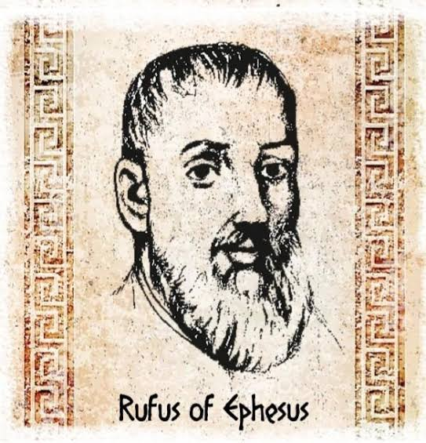
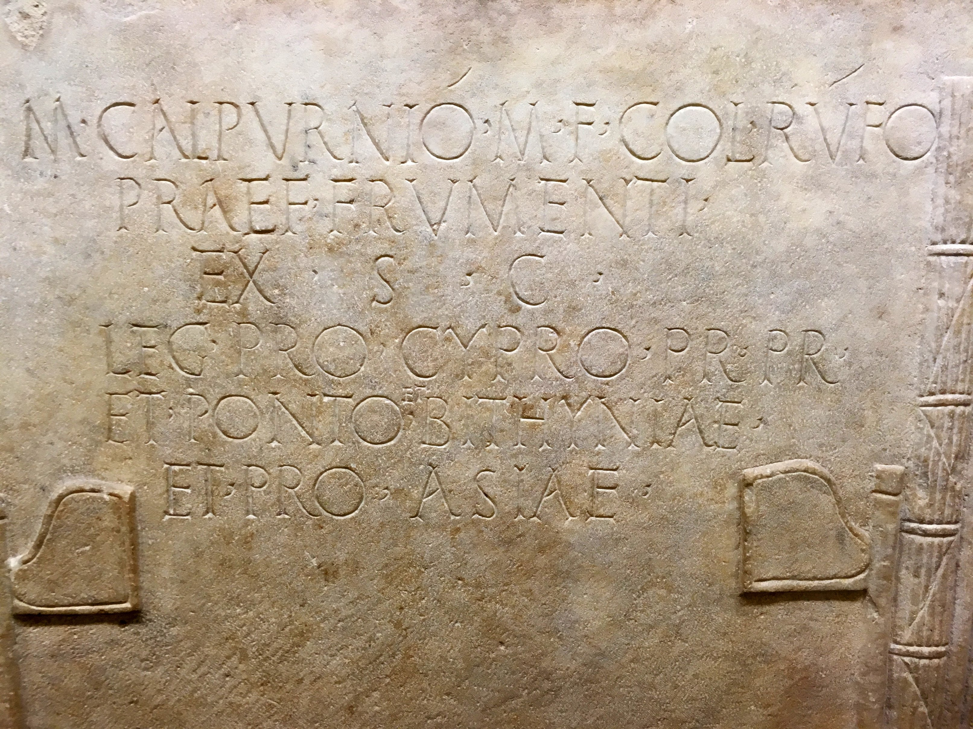
Let’s look at the text

Slide 15
Albrecht dÜrer the four horsemen of the apocalypse
White horse of conquest
Red horse takes away peace (War)
Black horse of famine
Pale green horse of Death

Slide 16
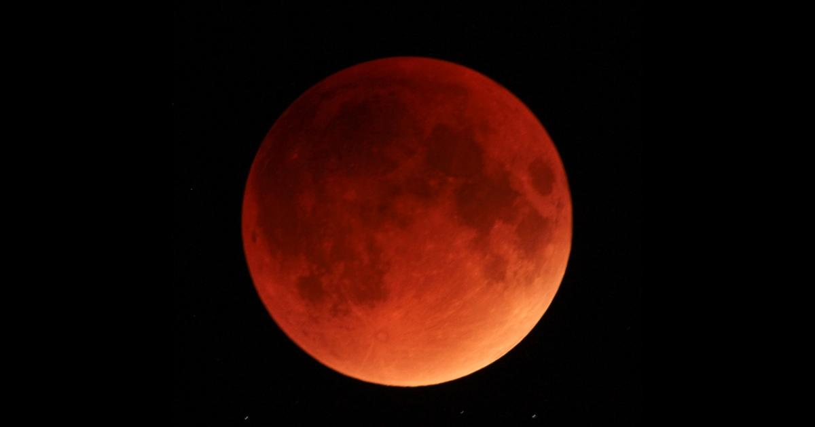
Let’s change this up! From R. H. Charles

Slide 17
the fifth seal portrayed
“The chopping block of the Roman executioner has become a cosmic altar. Christians who refused to sacrifice to the image of the emperor are nonetheless Christian priests who sacrifice themselves on the altar of God.” --M. Eugene Boring quoted in Reddish p. 130
Why under the altar?
Leviticus 4:7 (blood of the sacrifice is poured at the base of the altar)
Lives = blood (Leviticus 17:11)

Slide 18
Examine the text

Slide 19
With regard to vindication
After a betrayal by Cardinal Richelieu of France, Anne of Austria retorted: “The Almighty, my Lord Cardinal, does not pay every week, but at the last he pays.”
Baron Friedrich von Logan German Poet (1604-1655) quoted by B. H. Carroll
The mills of God grind slowly,
But they grind exceeding small;
Though with patience He stands waiting,
With exactness grinds He all.

Slide 20
Cosmic judgment

Slide 21
When I blot you out, I will cover the heavens, and make their stars dark; I will cover the sun with a cloud, and the moon shall not give its light. All the shining lights of the heavens I will darken above you, and put darkness on your land, says the Lord God.
God’s judgment against Egypt in Ezekiel 32:7-8 (NRSV)

Slide 22
All the host of heaven shall rot away, and the skies roll up like a scroll. All their host shall wither like a leaf withering on a vine, or fruit withering on a fig tree.
God’s judgment against the nations in Isaiah 34:4 (NRSV)

Slide 23
For the stars of the heavens and their constellations wil not give their light; the sun will be dark at its rising, and the moon will not shed its light. I will punish the world for its evil, and the wicked for their iniquity…
God’s word on Day of the Lord (judgment) in Isaiah 13:10-11a (NRSV)

Slide 24
I will show portents in the heavens and on the earth, blood and fire and columns of smoke. The sun shall be turned to darkness, and the moon to blood, before the great and terrible day of the Lord comes.
Warning about the Day of the Lord from Joel 2:30-31 (NRSV)

Slide 25
For the days are surely coming when they will say, ‘Blessed are the barren, and the wombs that never bore, and the breasts that never nursed.’ Then, they will begin to say to the mountains, ‘Fall on us;’ and to the hills, ‘Cover us.’
Jesus warns the people of Jerusalem in Luke 23:28-30 (NRSV)

Slide 26
Bottom line?
God’s timing is perfect and his judgment is appropriate but… sometimes God’s people have to “wait”

