Slide 1
What’s In The Scroll?
Revelation 5

Slide 2
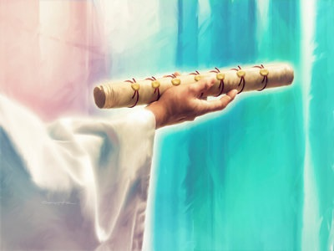
Scroll Upon the Right Hand (v. 1)
Held loosely with confidence?
Extended because unchangeable?
Extended to offer?
Right is not “sinister”
What God has sealed (for security), no human or angel is worthy to know

Slide 3
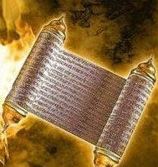
Written on Both Sides (v. 1)
Usually, because of the way the papyri were assembled—one side smooth, other rough
Technical term -- ὄπιθροσον opisthrosov
Every space needed because everything was inside
Ezekiel 2:9-3:3 tastes like honey, full of woe, judgment

Slide 4
Seven Seals (v. 1)
Seals identified sender
Seals kept contents safe
Assuming this scroll contains, not only judgments and woes like that of Ezekiel …
But is a deed of promise as in Hebrews 9:15-28, …
No wonder there was silence in heaven after 7th seal (8:1)

Slide 5
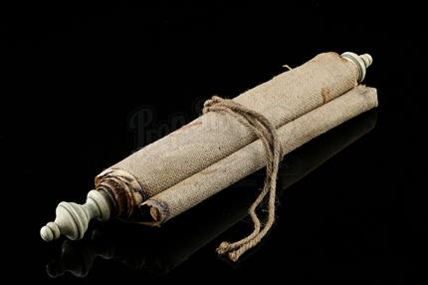
What’s the Big Deal?
Why did John weep when the seals were holding back all the bad stuff?
Because the “good part,” “the deed,” “the promise” wouldn’t happen until God finished His purpose in history
Because their suffering wouldn’t end until history was over

Slide 6
Messianic Genealogy
“Judah is a lion’s whelp; from the prey son, you have gone up. He crouches down, he stretches out like a lion, like a lioness—who dares rouse him up? The scepter shall not depart from Judah, nor the ruler’s staff from between his feet, and tribute comes to him.” – Genesis 49:9-10 RSV
“A shoot shall come out from the stump of Jesse; and a branch shall grow out of his roots. The Spirit of the Lord shall rest on him, the spirit of wisdom and understanding, the spirit of counsel and might, the spirit of knowledge and the fear of the Lord.” Isaiah 11:1-2 RSV

Slide 7
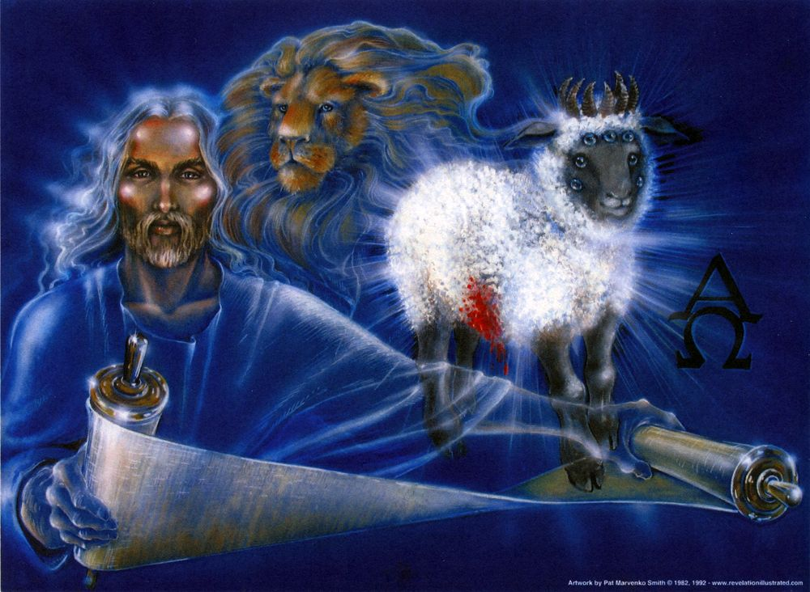
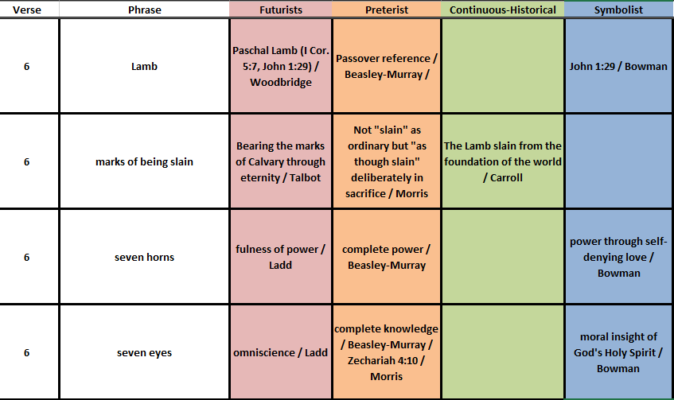
The Lamb Imagery (28x in Revelation)
Throne = Power
Lamb = Vulnerability

Slide 8
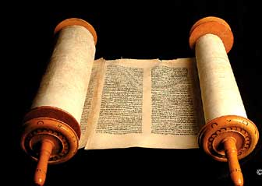
Scroll of Destiny
Apart from Jesus, history is an enigma
The Lamb’s role will be vital
“By opening the scroll, the Lamb does not merely disclose its contents, but puts them in operation.” G.B. Caird

Slide 9
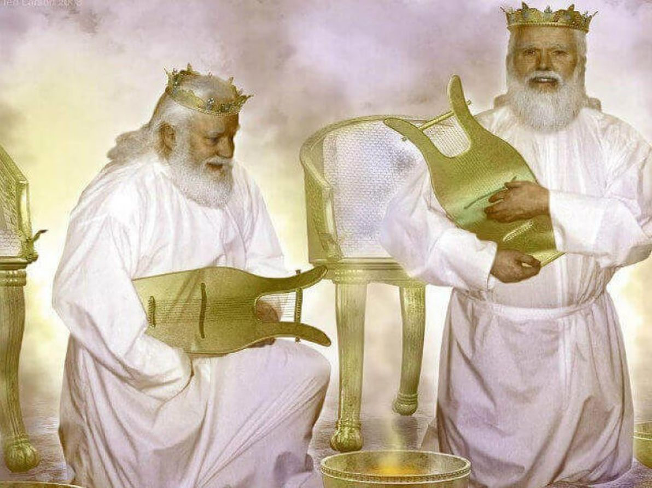
Hymn of Creation and the Redeemed (v. 8
The four living creatures represent all of creation
The 24 elders represent God’s leaders in Old and New Covenants
The bowls have the prayers of the saints, representing redeemed on earth
The harps represent worship music and may be where the common idea started

Slide 10
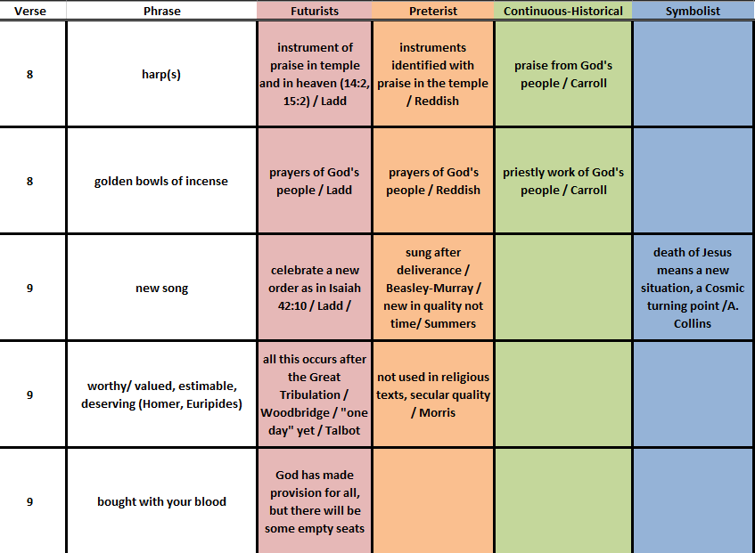
Worship Begins
Summers notes four qualitative terms:
purchased for God,
2) through Christ's blood,
3) unlimited (all nations),
4) makes redeemed a kingdom
Redemption

Slide 11
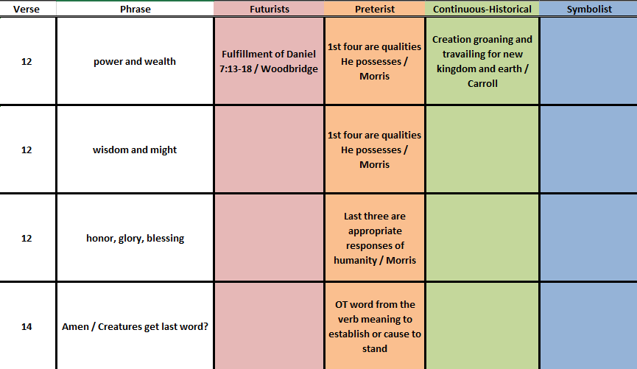
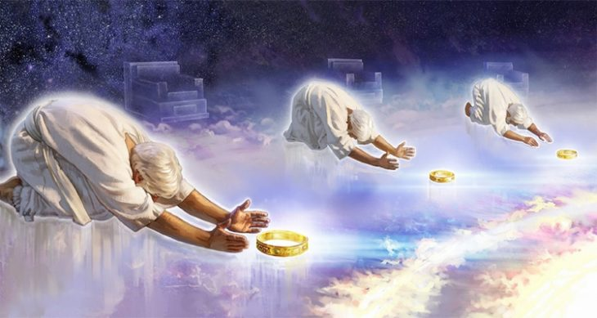
Hymn of the Heavenly Beings

